Slide 1




The effects of equivalence ratio during shutdown of a rocket engine on hardware longevity
Benjamin Black
Dr. Elliott Bryner
2021 Arizona Space Grant Symposium
April 17th, 2021

Slide 2

Outline
Problem Statement
Testing goals
Benefits
Method
Conclusion
Acknowledgements

Slide 3
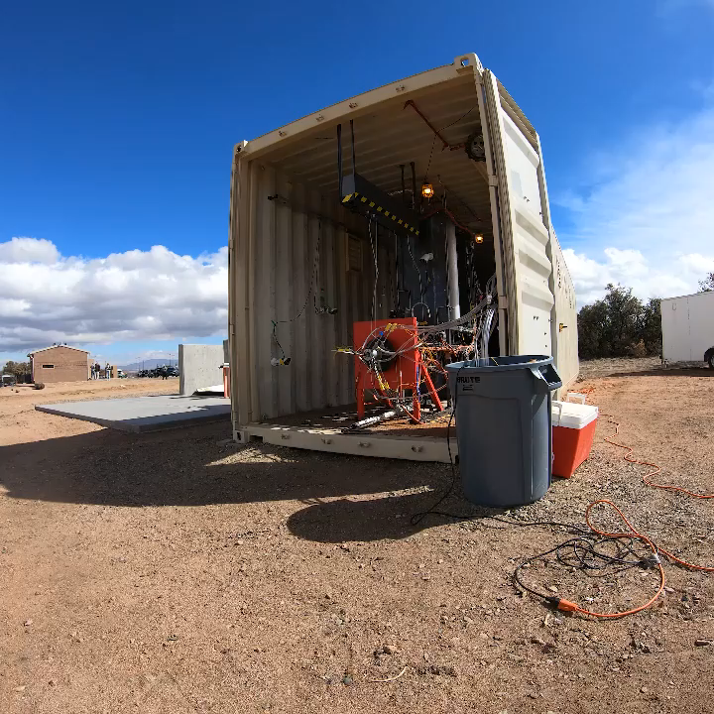
The Problem
During shutdown oxidizer and fuel flow varies widely.
This causes the pressure and temperature to spike.
Unpredictable and extreme conditions in the engine lead to damage.

Slide 4
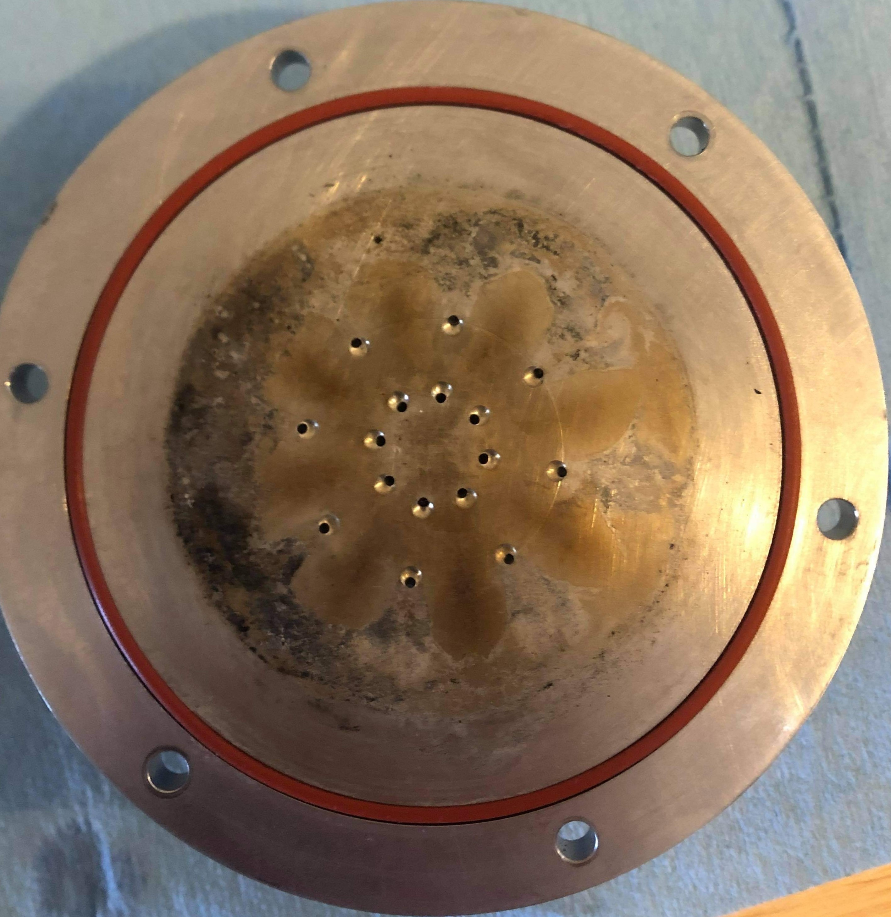
Testing Goals
Isolate the events that contribute to temperature and pressure spikes.
Determine the exact sequence of events to prevent these conditions.

Slide 5

Benefits
In depth combustion & thermo-chemistry education.
New test hardware for the propulsion testing complex.
Increased test team safety.
Better test hardware durability and longevity

Slide 6
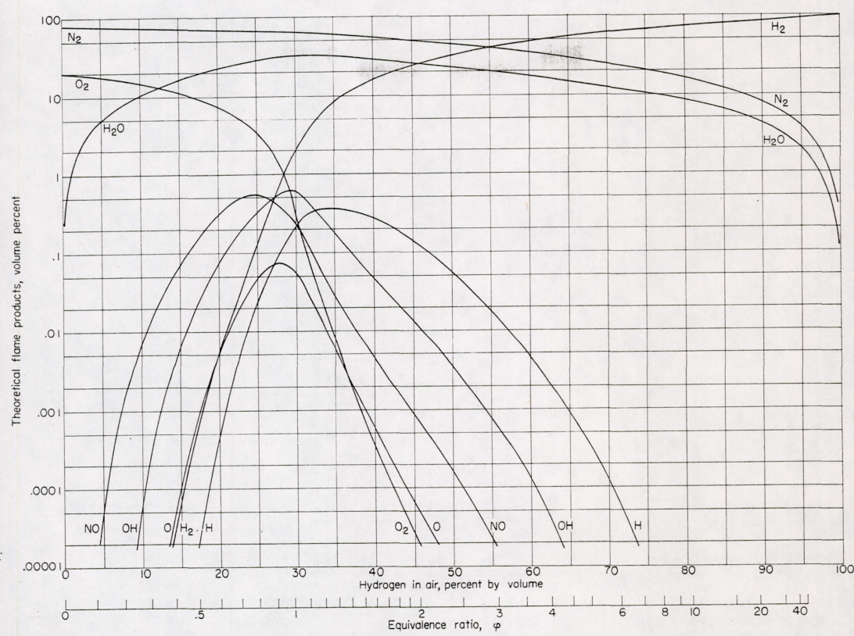
Methods
Initially a model of flame temperatures as well as reaction products was used to determine the best fuel gas to use for a scale test.
A commercial exhaust gas analyzer tool was pursued for a short time to see if exhaust gas composition could be determined as well as temperature and pressure.
Source: NASA Technical Report Server

Slide 7
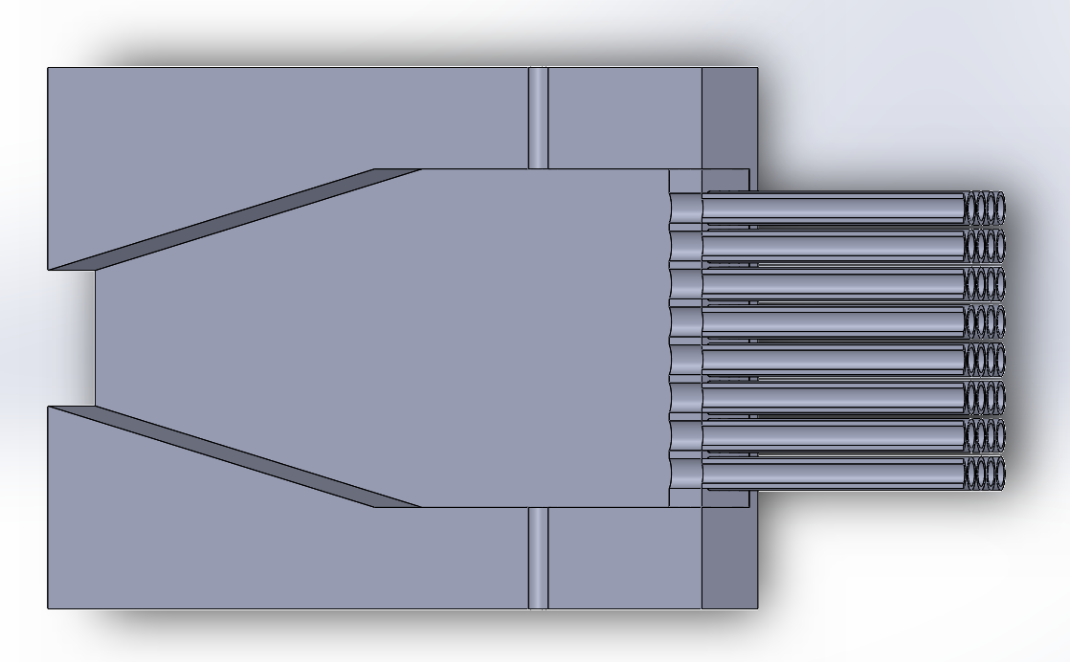
Methods
The testing method decided on to move forward is scale gaseous burner testing with a minimally convergent combustion chamber.

Slide 8
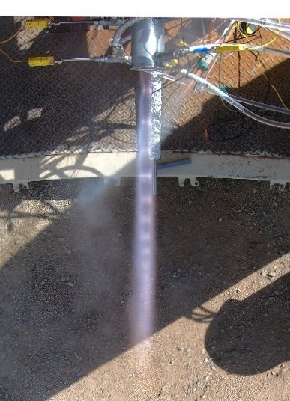
Conclusion
Finish the manufacturing and assembly of the gaseous scale testing fixture.
Analyze the data and define factors of similarity with liquid rocket engines.
Test the process determined at small scale on the Kairos liquid rocket engine.

Slide 9
Acknowledgements
Arizona Space Grant through the Undergraduate Research Institute.
Dr. Bryner and the rocket propulsion testing complex.
The Rocket Development Lab.

Slide 10
Thank you for listening
Questions?

